Slide 1
Milestone Projects
Mark Pratt & Patrick Garcia
CST-247

Slide 2
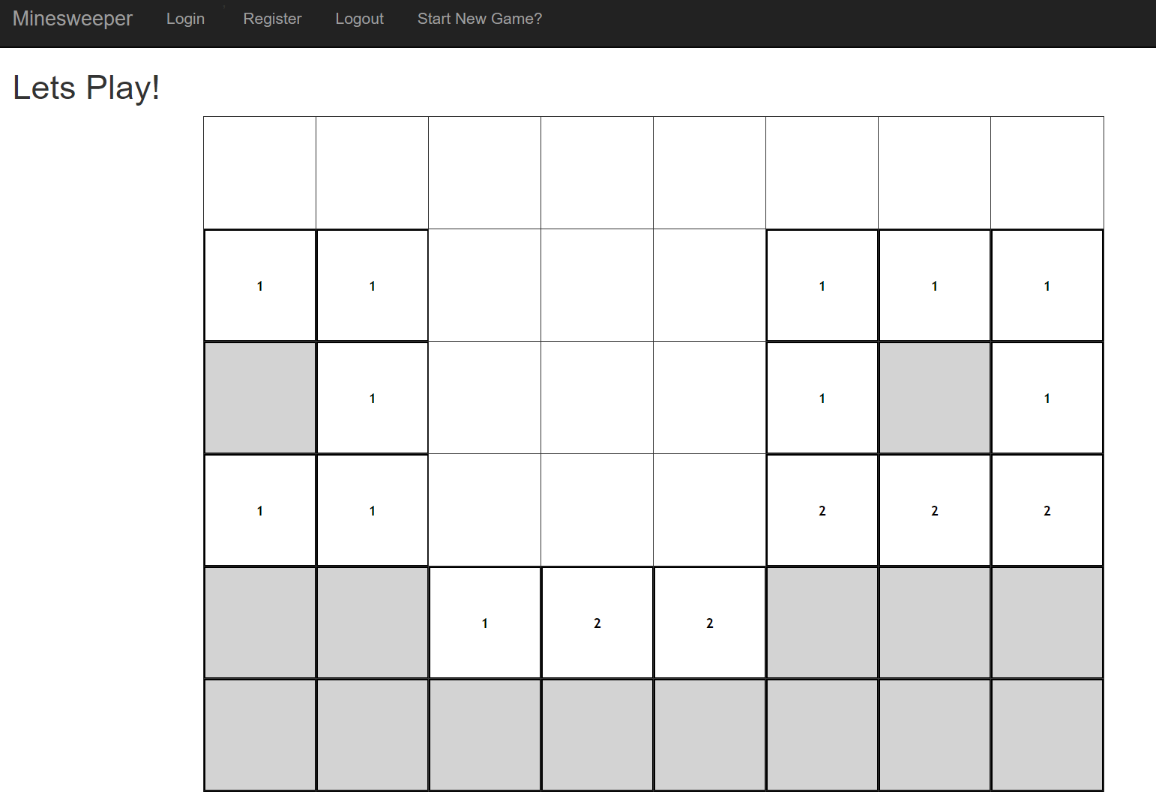
Project Overview
We took the game of Minesweeper from CST-227 and turned it into a web app using ASP.NET / MVC
The project has Registration and Log in functionality
The project has the ability to restore a saved game state
We utilized the SCRUM tactic of project management to deliver this project

Slide 3
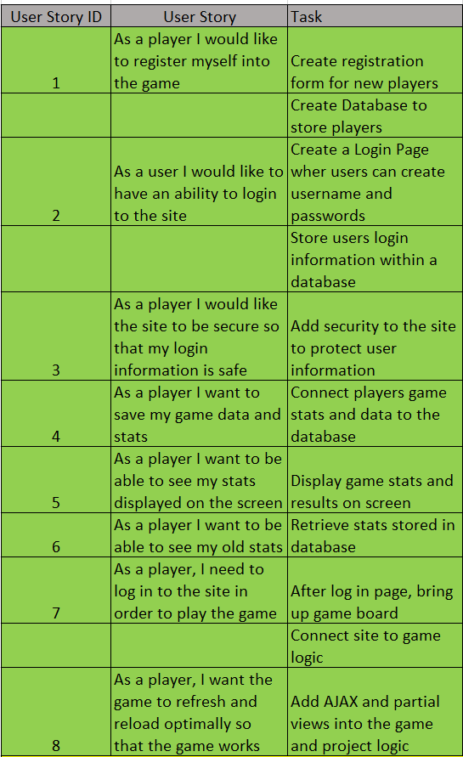
Scrum Artifacts
Here are our user stories, this is what we used to ensure we did all of the correct tasks and kept the game on schedule

Slide 4
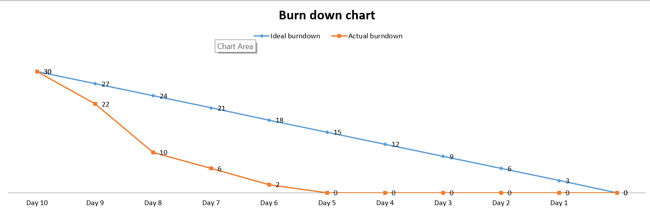
Scrum Artifacts Part II
Here is the burndown chart associated with the user stories. As you can see we were well ahead of schedule, our actual time was under the ideal time.

Slide 5
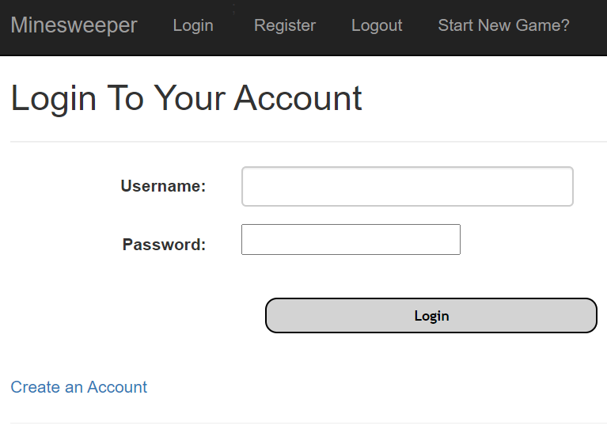
Log In
We used MVC functionality to create a log in module. The module uses DAO design principles to connect and query a database with the user credentials.
The module checks the database for the existing user, and if they do, then it returns their credentials and also their saved game state if applicable.

Slide 6
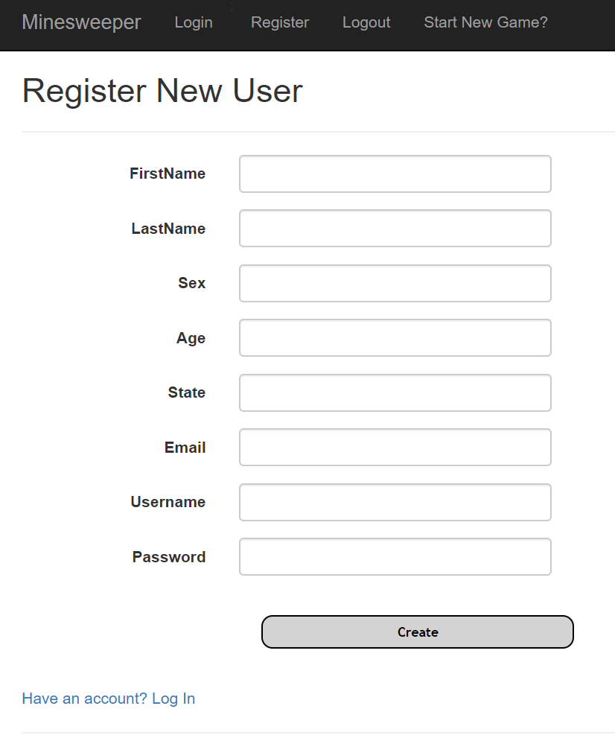
Registration
We used MVC functionality to create a registration module. The module uses DAO design principles to connect and query a database with the user credentials
The module checks whether the user has already been created, and if they haven’t, it adds a new user to the database.

Slide 7
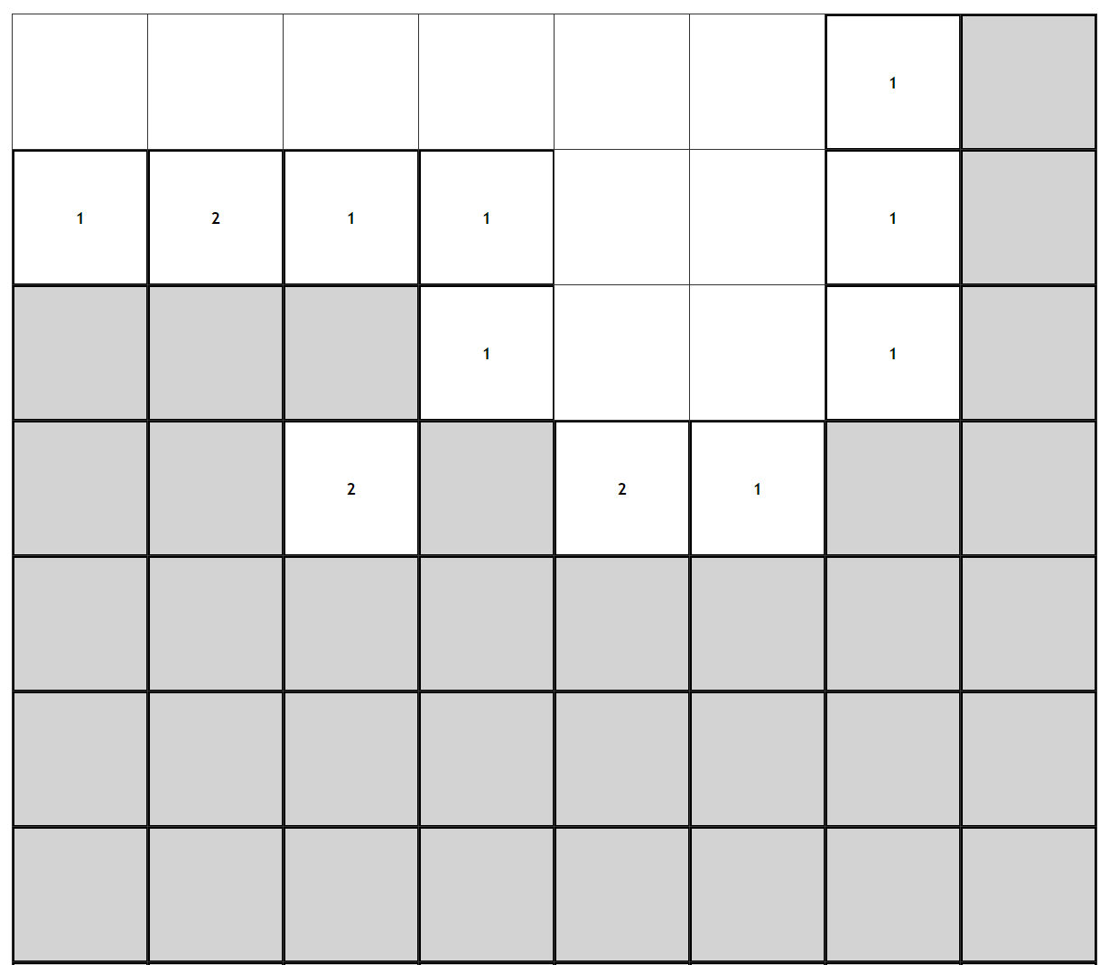
Board Game Module
Our board is a 2d array of buttons with click functionality. Each button houses a cell object which has its own functions. The board uses separation of presentation and logic layers.

Slide 8
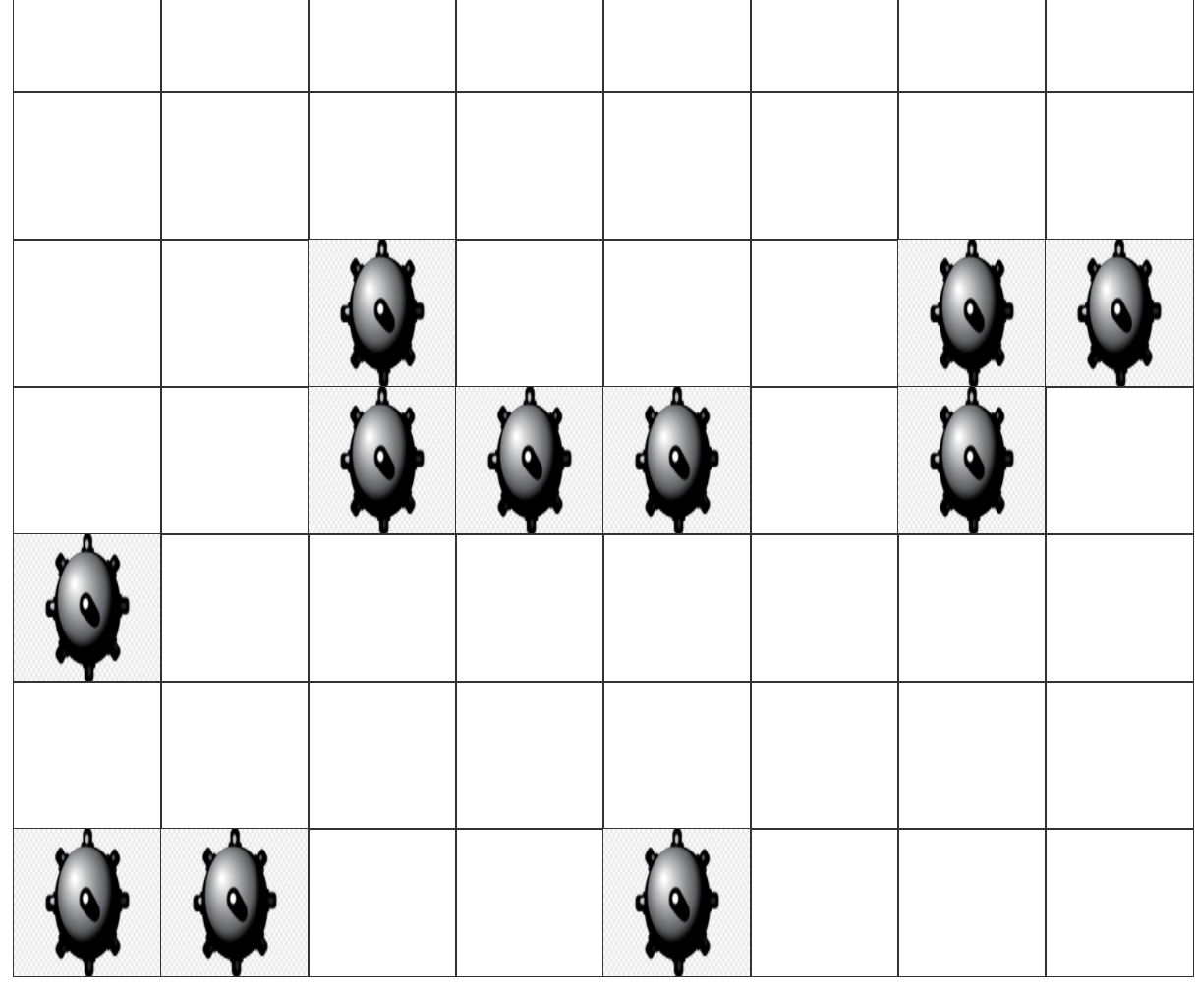
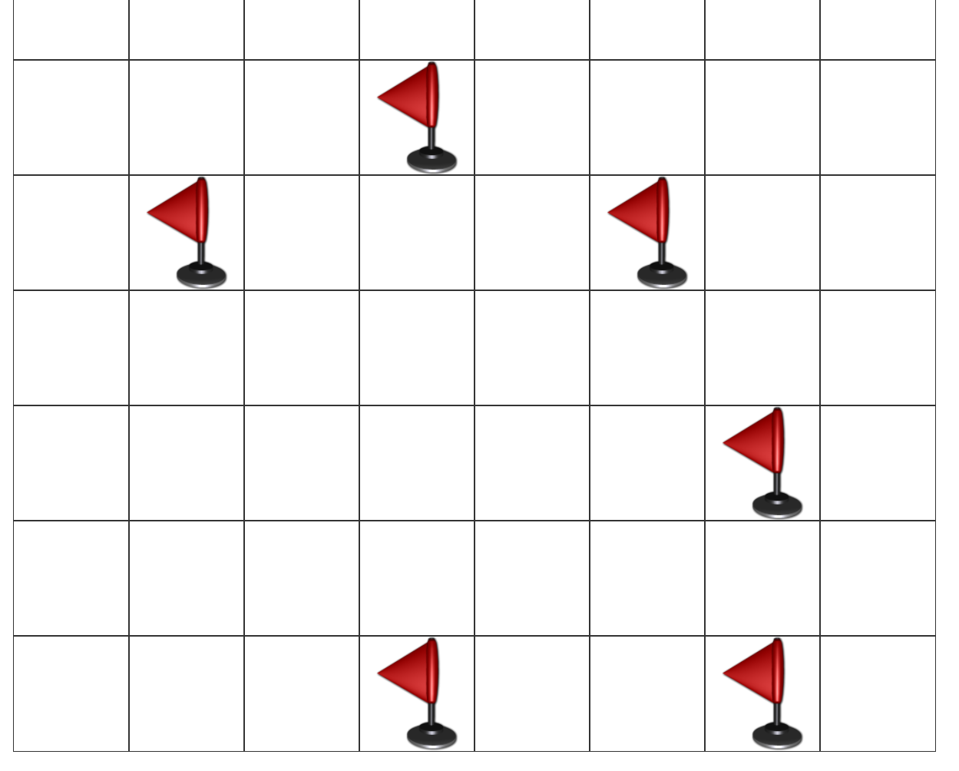
Win / Loss Board
The board shows different things whether you win our lose. When you win, you can see flags where the bombs were, but when you lose, you see the bombs

Slide 9
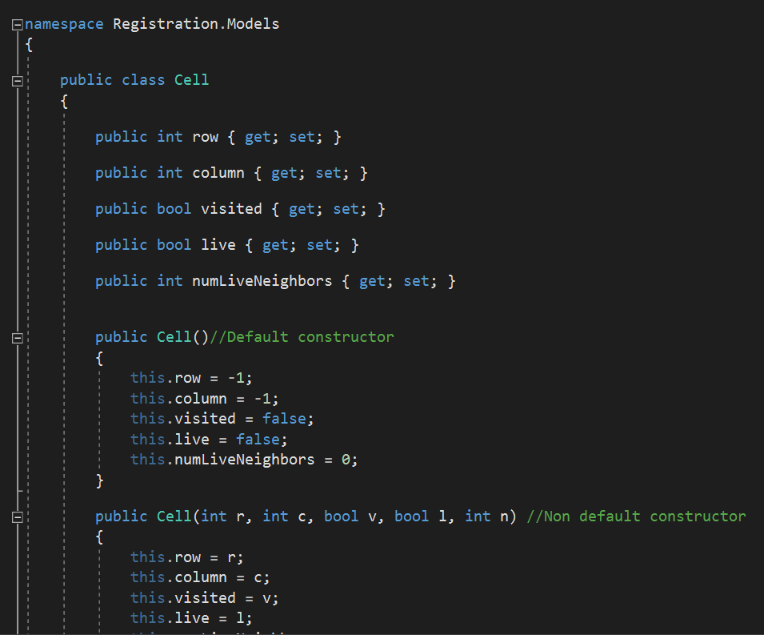
Cell Object
Each cell is its own object. Each cell object has properties as can be seen in the image.

Slide 10
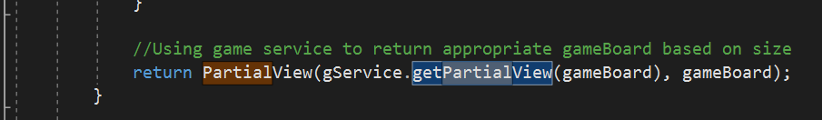
AJAX and Partial Views
We utilized AJAX and some Partial Views to help our project be more optimized at runtime and help with refreshing.
Our game board has partial views within it to help with refreshing when a cell is clicked.

Slide 11
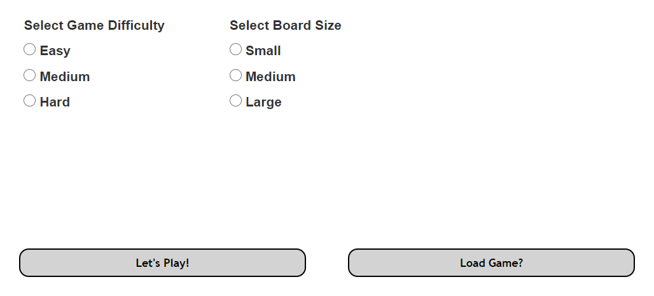
REST Features and Saved Game State
Our project uses REST features in order to create a save game state that can be returned to at a later time.
When logging in, you can choose to load a saved game through the load game button

Slide 12
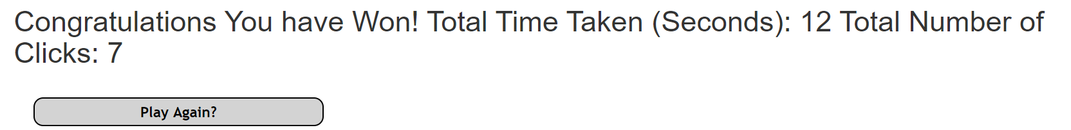
REST Features and Saved Game State
With the REST features, we have player stats as well. Some of these player stats are the number of clicks and the time taken to win the game.

Slide 13
Thank you
Thank you for viewing our project

